Slide 1
Motion Capture Hand Postures Data Set
Semester Project Part2
Group #8 Enjam, Siddharth Reddy Chirumamilla, Manoj Kumar Gubba, Vinod Kumar Antony, Shaji

Slide 2
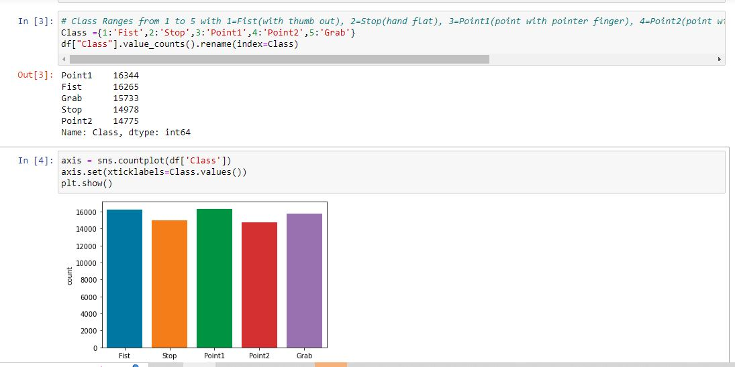
Summary of Project information and
Classification of dataset
Data selected: Motion Captured Hand Posture Data Set( MoCap)
Vicon motion captured system
Hand posture type :5 types, 11 markers
Task: Classification
Data Characteristic: Multivariate
Number of Instances:78,095
Number of Attributes: 38
No. of Classes: 5 (Fist, Grab, Stop,
        point 1, point 2)
Done the preprocessing of Data and Stored into a CSV file.

Slide 3
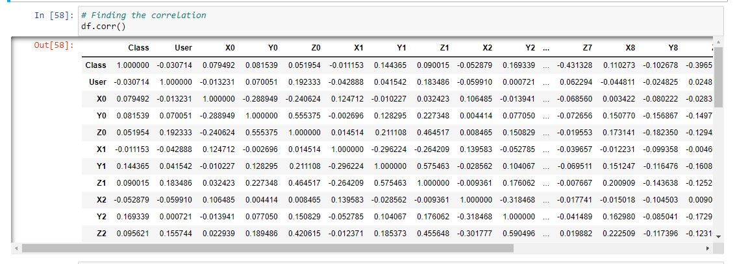
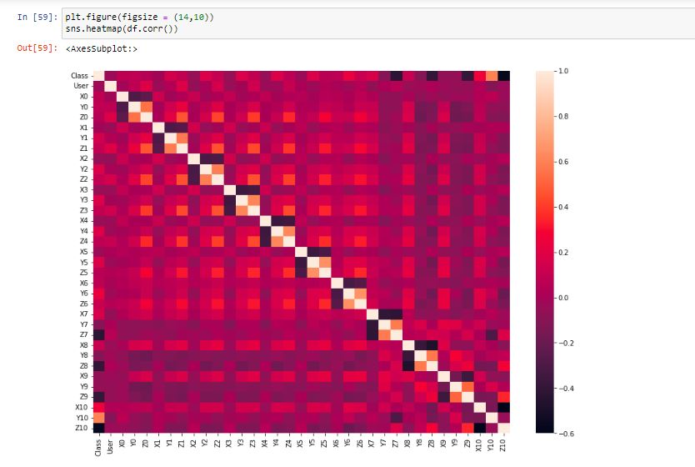
The Correlation and Heat Map for the Cleaned Data
Models used For Linear Classification
We have performed the following 4 modeling technique for the preprocessed dataset.
  Linear Classification 3. Random Forest
  KNN 4. Decision Tree

Slide 4
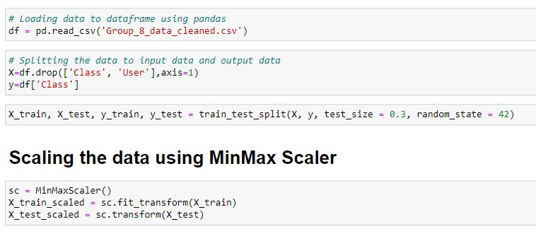
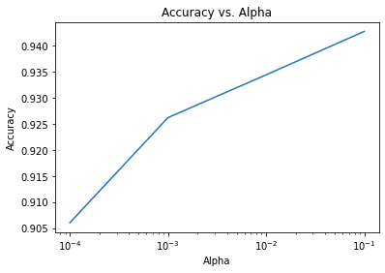
Linear Classification

Slide 5
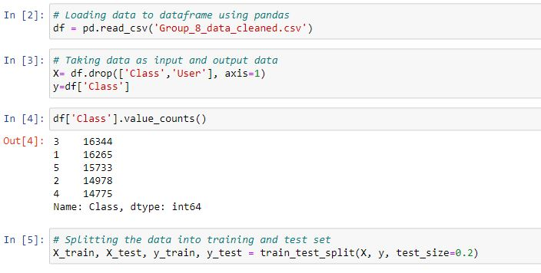
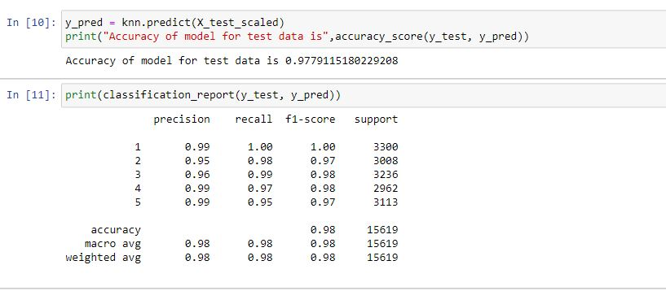
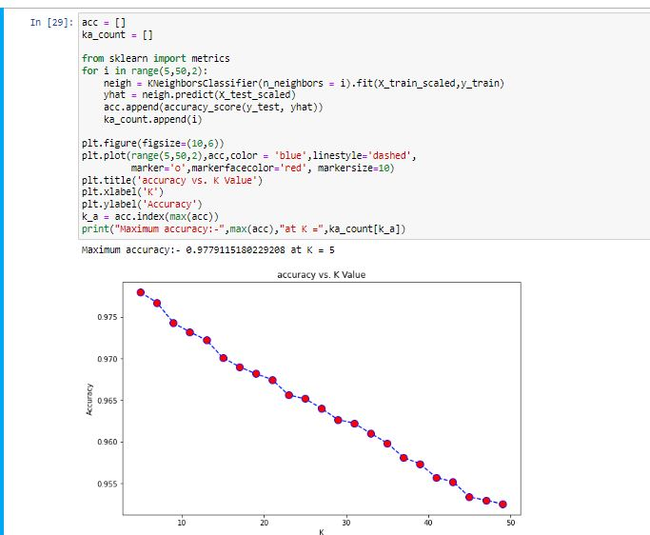
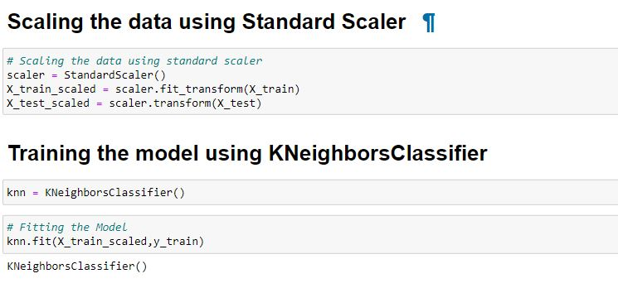
Classification using KNN

Slide 6
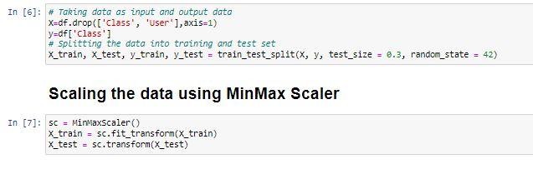
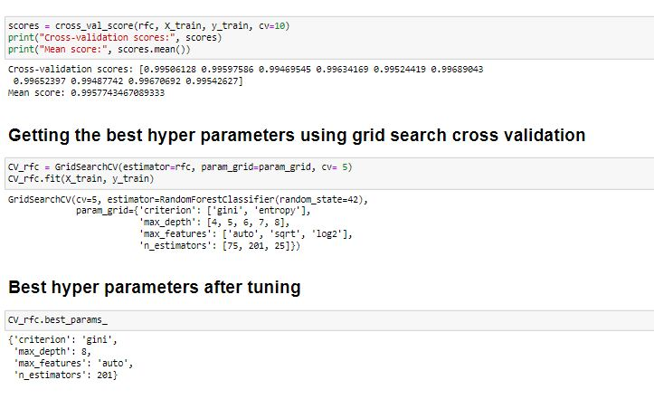
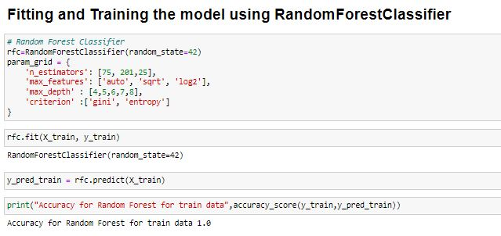
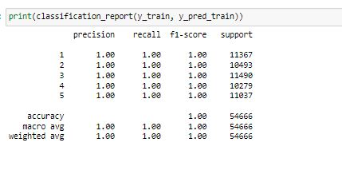
Classification using Random Forest

Slide 7
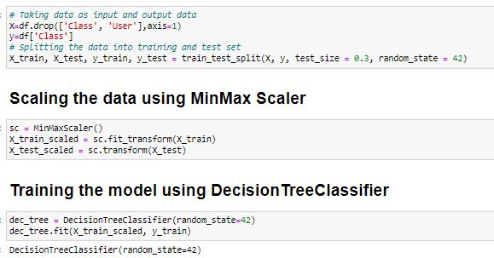
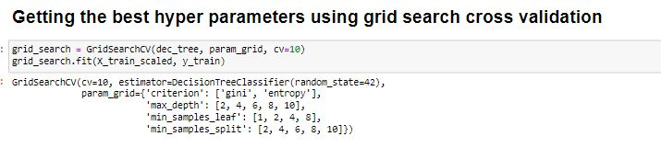
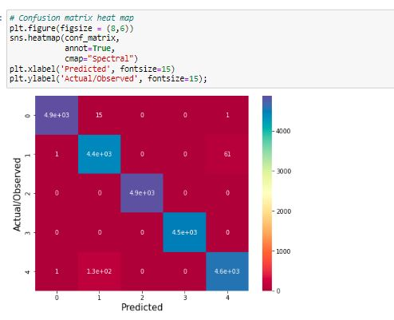
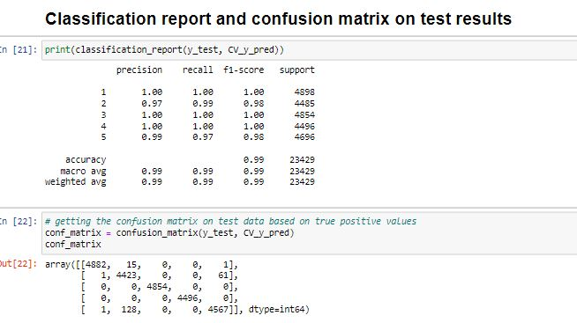
Classification using Decision Tree

Slide 8
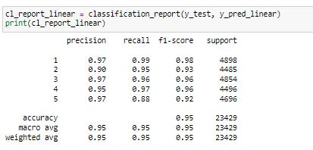
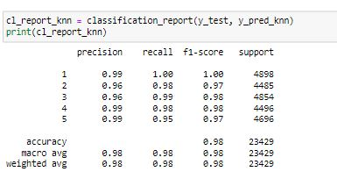
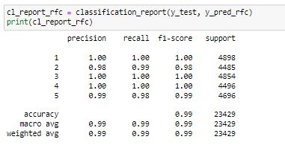
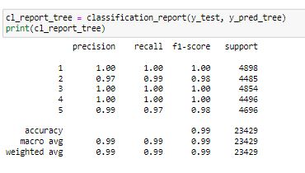
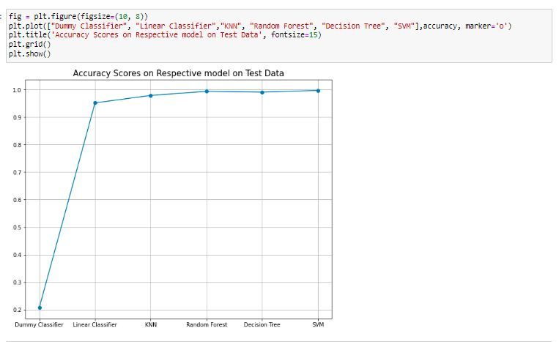
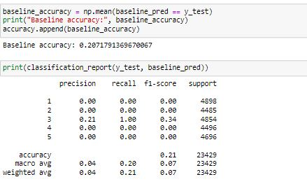
Comparison with Naïve and test Results

Slide 10
Performed the classification of the dataset using four modeling, Linear classification, KNN, SVM and Random Forest.
Performed the linear classification following:
Import the necessary packages from the library
Load the dataset and build a training and testing dataset out of it.
Plot the training instances.
Create object of the SGD classifier, initialize its parameters and train the model.
Evaluate the result by using the metrics and report results.

Slide 11
Models used For Linear Classification
We have performed the following 4 modeling technique for the preprocessed dataset.
  Linear Classification
  KNN
  Random Forest
  Decision Tree

Slide 12
We have performed the KNN Classification from the dataset cleaned from the first part of the project.
Importing the modules from library
Standardize the data using scaler function using mean -0 and std -1
Split Data into Training and Testing Datasets ( Test data-20%)
Implement KNN Classifier, Validate data using K-fold validation, Predict for the KNN Classifiers
Predict Accuracy and Error rate. Find the confusion matrix for test and train data and the accuracy and error for K Values.

